Slide 1

PMOD SSD with switch and LEDs
ECE 520 System on Chip Design
Christopher Y. Chen

Slide 2
Overview
Background
The Code
Demo

Slide 3
Background - PMOD
Pmod are Digilent defined small Input and output interface boards that provides addition extension to the programmable development boards
They allow sensitive signal conditioning circuits and high-power drive circuits to be placed place near the sensor and processor.

Slide 4
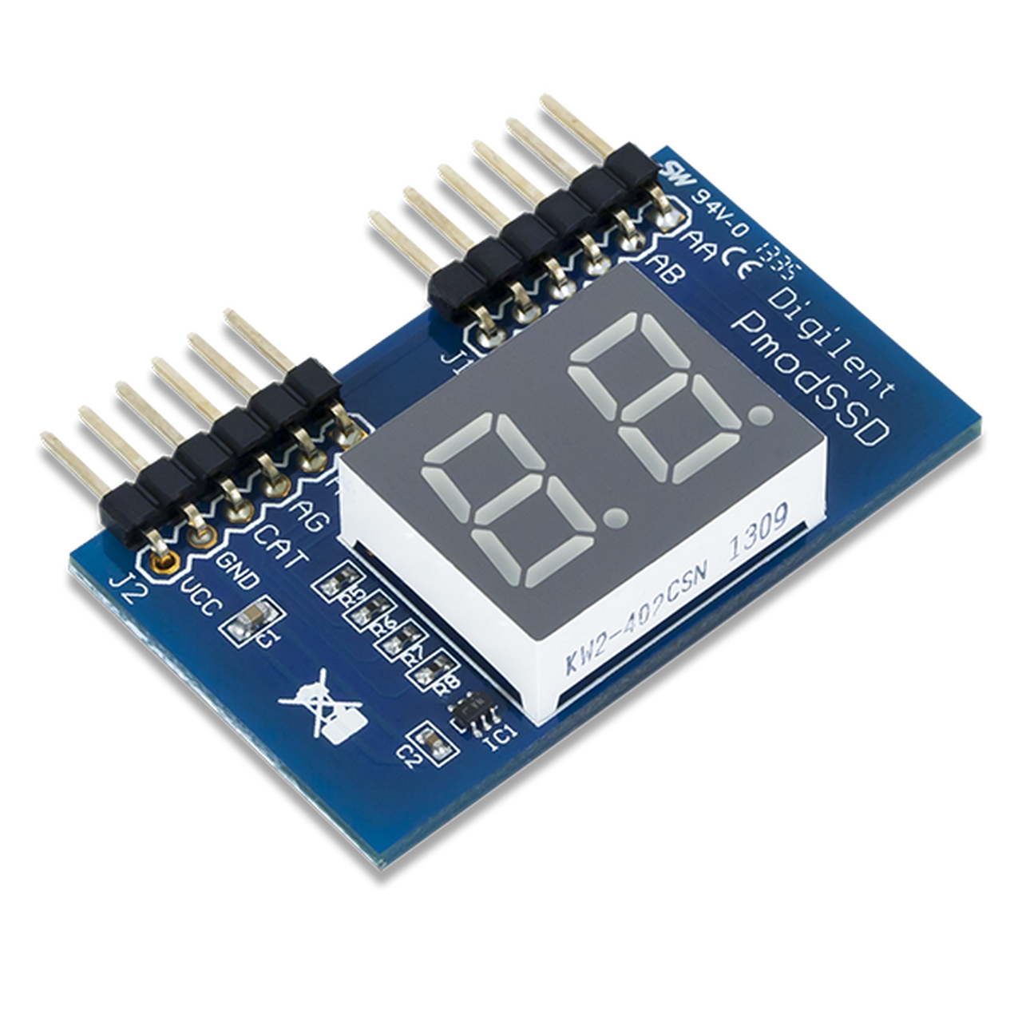
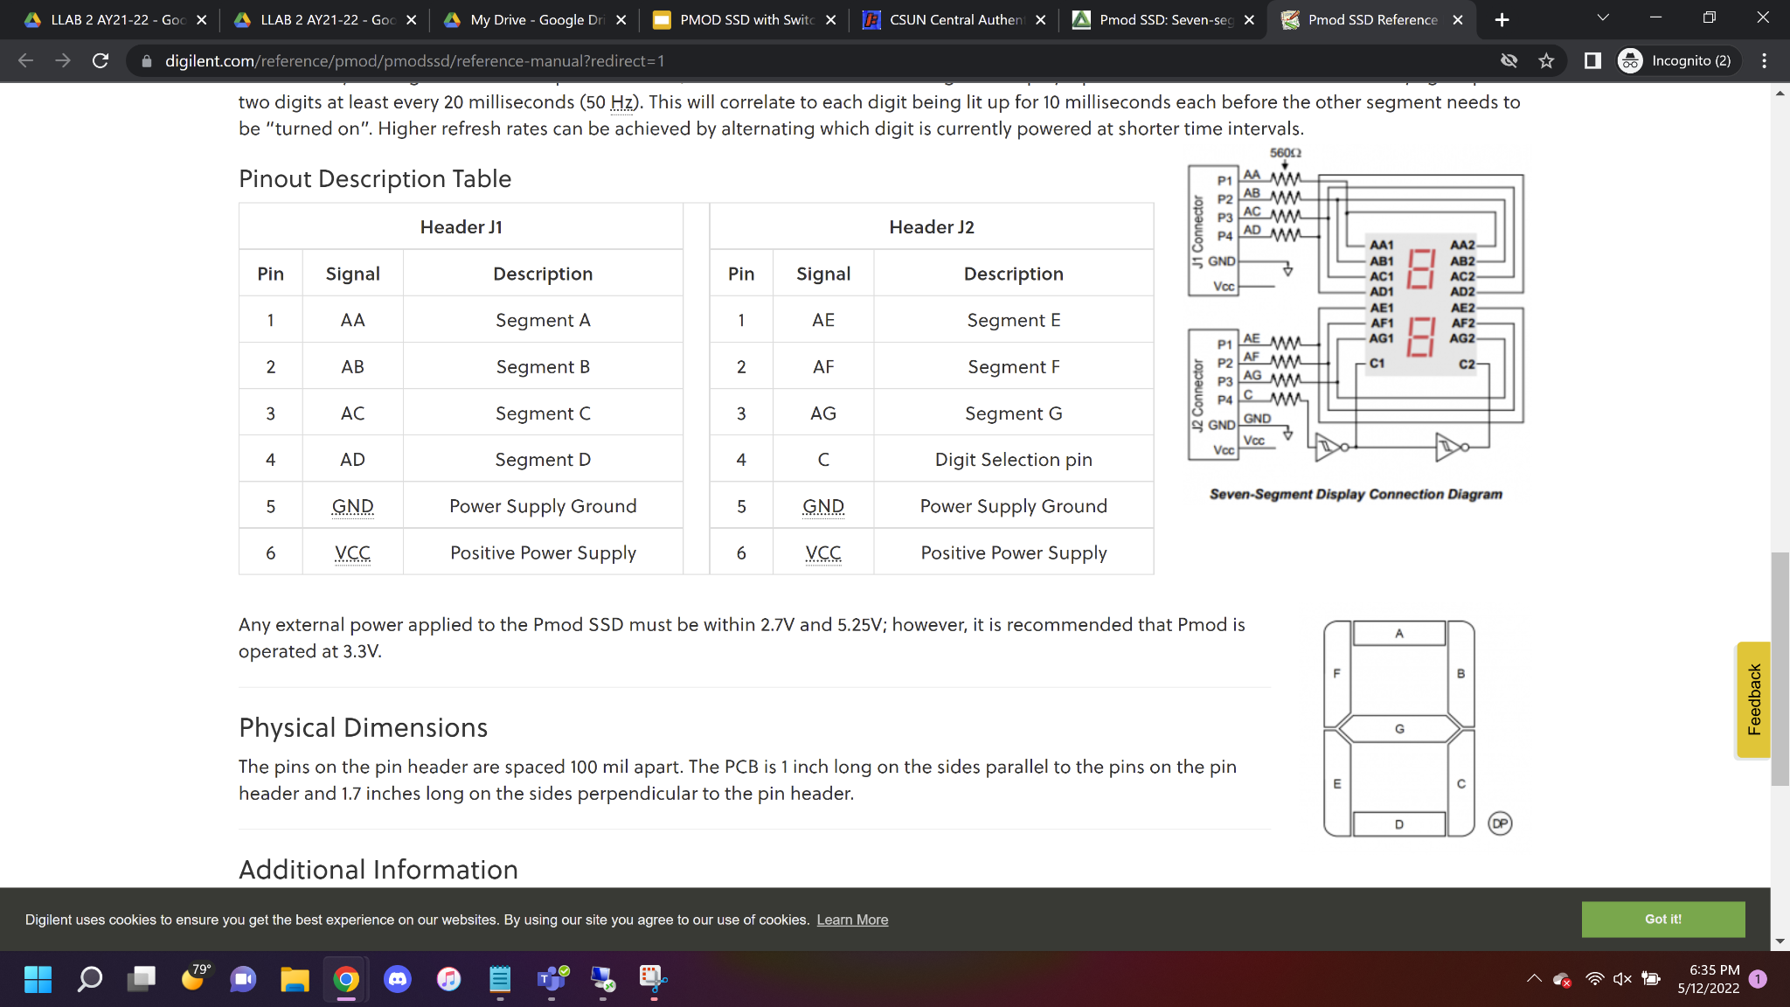
Background - PMOD 7 Segment LED
The Pmod SSD is a two-digit seven-segment display.
To achieve the two digits, the developer needs to toggle at a rate of 50Hz to trick the human vision to think that is two digits lits up simultaneously.

Slide 5
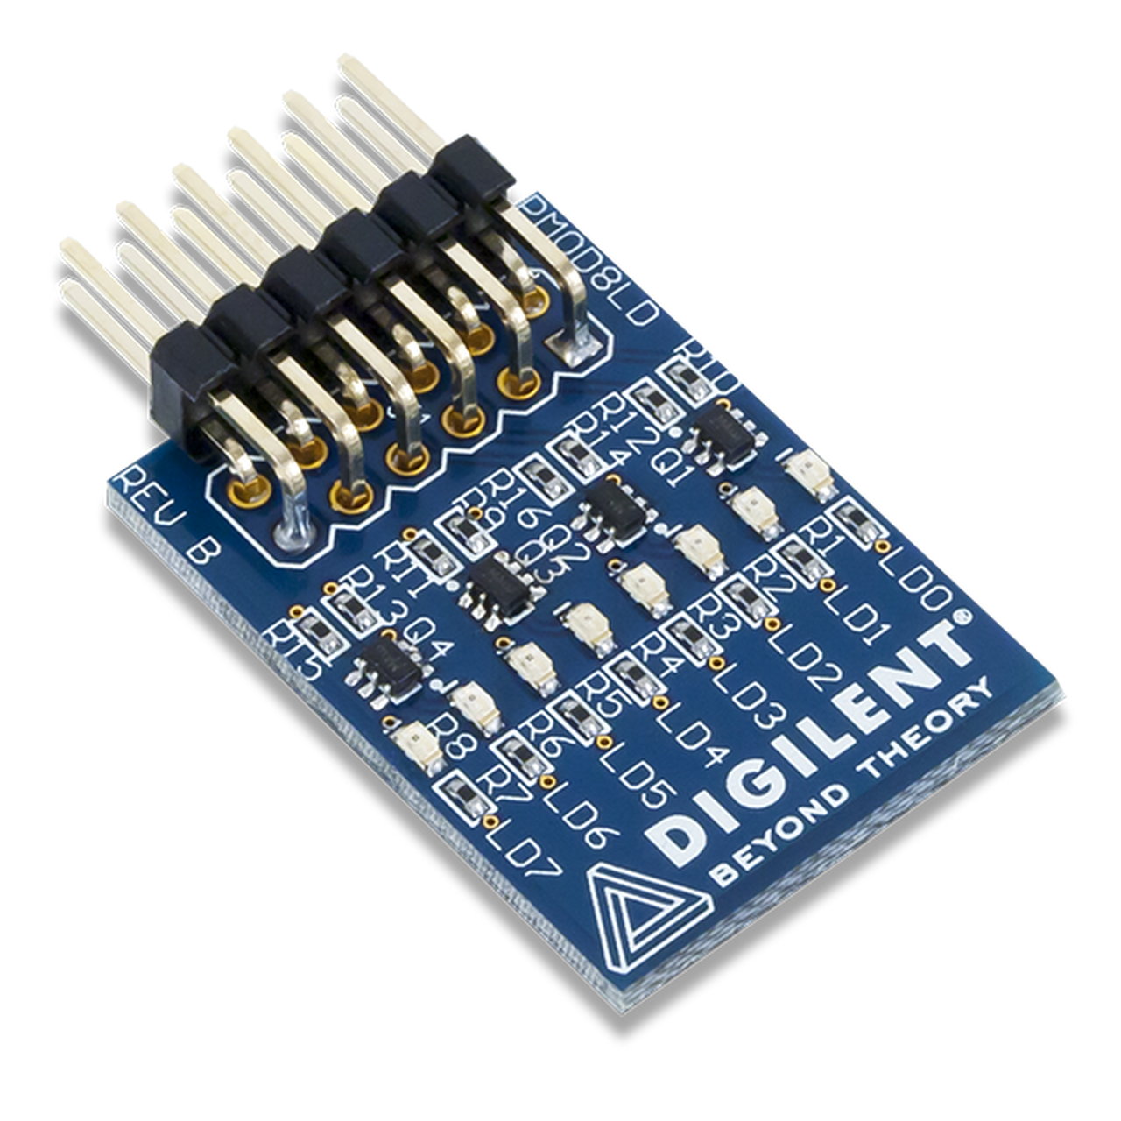
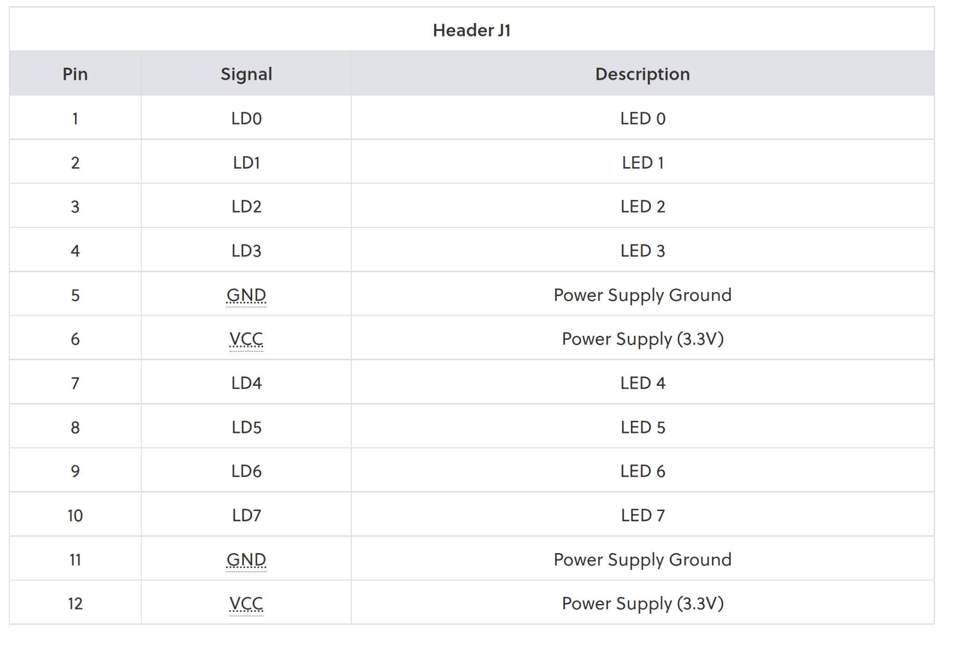
Pmod 8LD
The Pmod 8LD utilizes individual transistors so that each LED can be turned on or off independently.
I used the Pmod as the hexadecimal signal display guide for testing and troubleshooting.

Slide 6
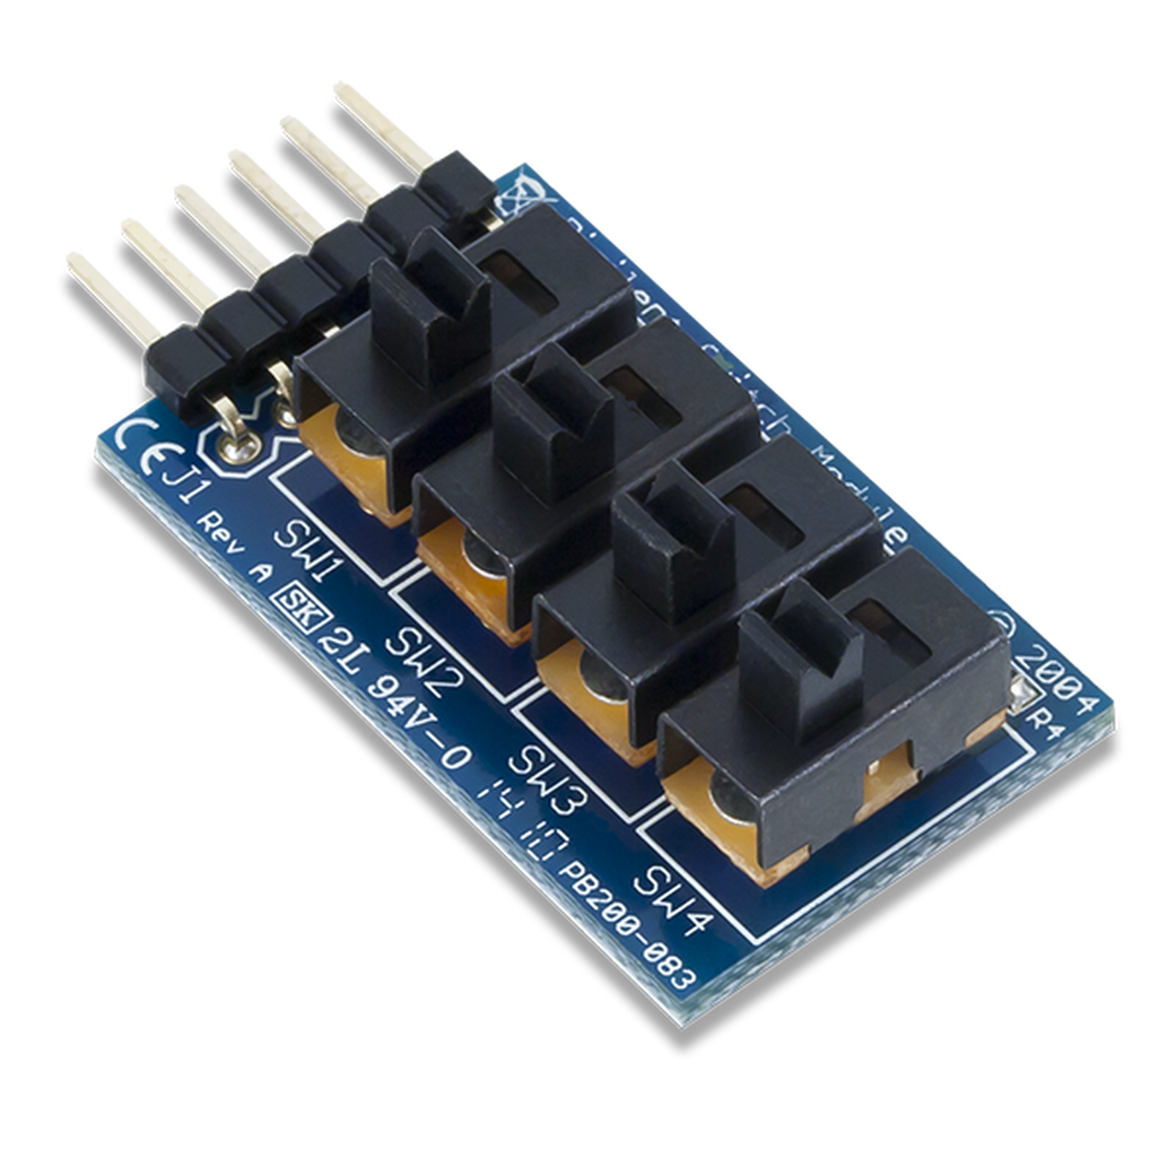
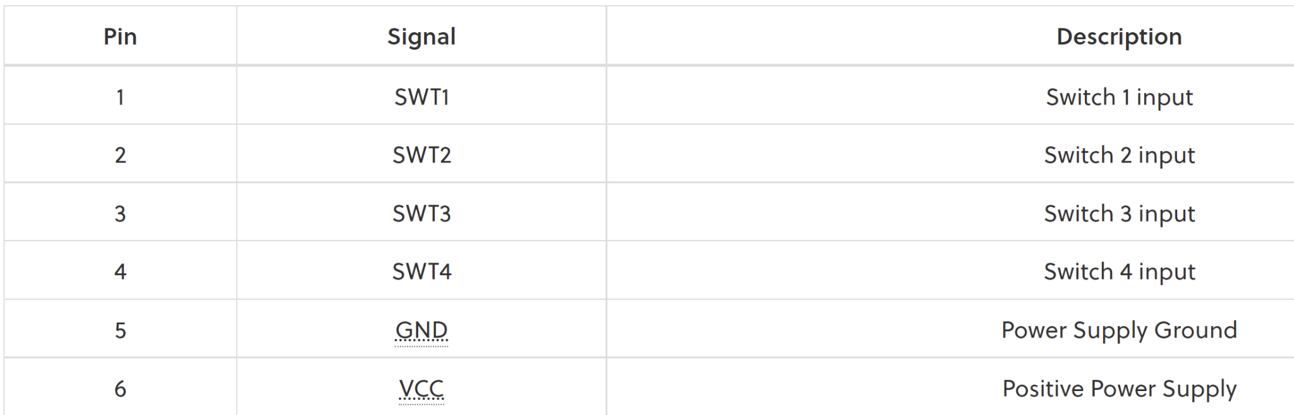
PMOD Switch
The Pmod Switch utilizes four slide switches that users can use as a set of on and off switches or as a set of static binary inputs.
Switch 1 will be the LSB and switch 4 will be the MSB.

Slide 7
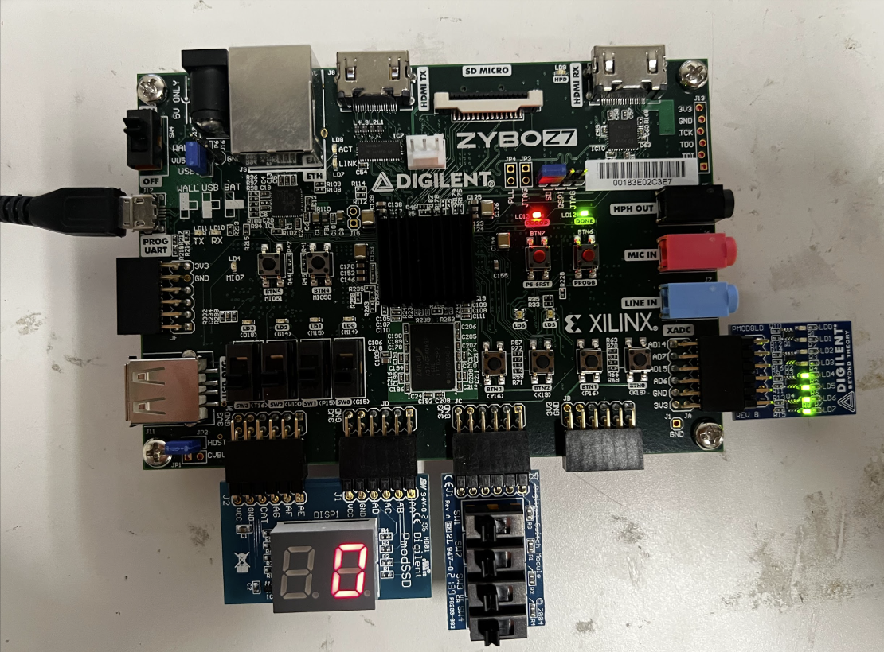
Hardware

Slide 8
Code
`timescale 1ns / 1ps
module pmod_LED(
input clk,
input [7:0] switch1,
output reg [7:0] p_led,
output reg [6:0] segements,
output reg digsel
);
always @(posedge clk)
case(switch1 [3:0])
0: segements <= 7'b0111111;
1: segements <= 7'b0000110;
2: segements <= 7'b1011011;
3: segements <= 7'b1001111;
4: segements <= 7'b1100110;
5: segements <= 7'b1101101;
6: segements <= 7'b1111101;
7: segements <= 7'b0000111;
8: segements <= 7'b1111111;
9: segements <= 7'b1100111;
endcase
always @(posedge clk) p_led <= switch1;
always @(*) digsel = 0;
endmodule

Slide 9
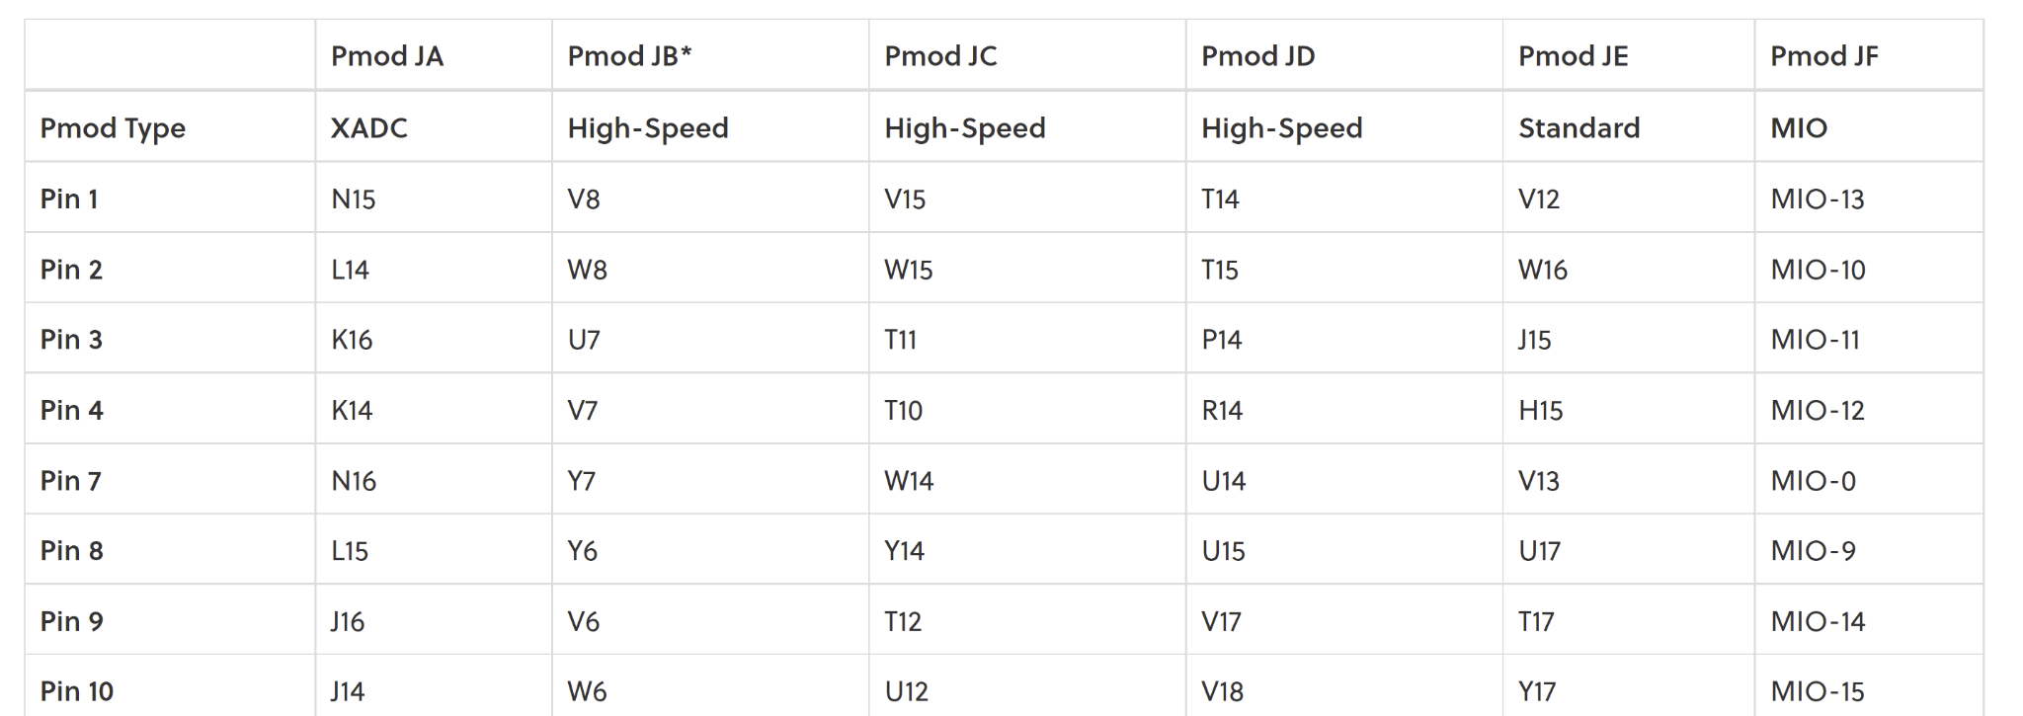
Pmod Ports

Slide 10
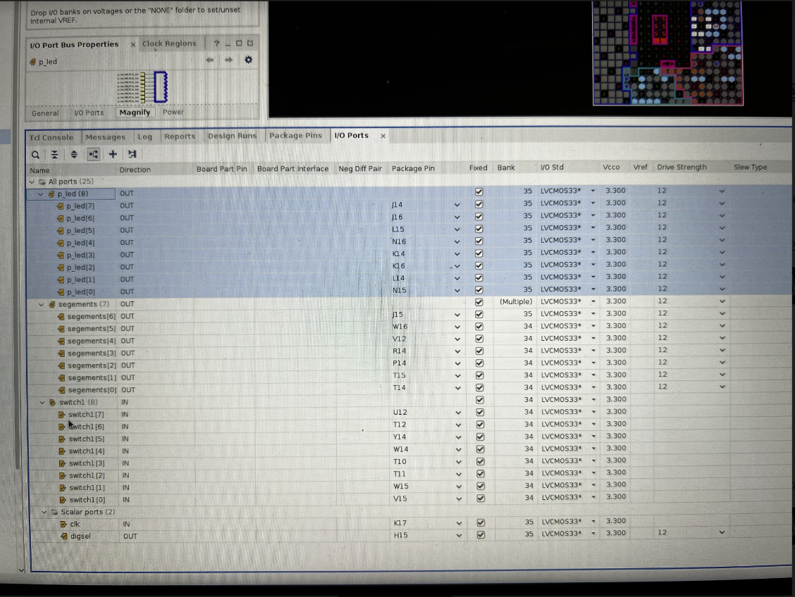
I/O Constraint mapping

Slide 11
Demo time!

Slide 12
Thank you!

